Slide 1
CS 4350: Fundamentals of Software Engineering Lesson 4.4: Debugging
Jonathan Bell, Adeel Bhutta, Ferdinand Vesely, Mitch Wand
Khoury College of Computer Sciences
© 2022 Released under the CC BY-SA license

Slide 2
Learning Objectives for this Lesson
By the end of this lesson you should be able to:
Understand the value of scientific debugging
Enumerate general debugging strategies beyond “google it” or “turn it off and on again”

Slide 3
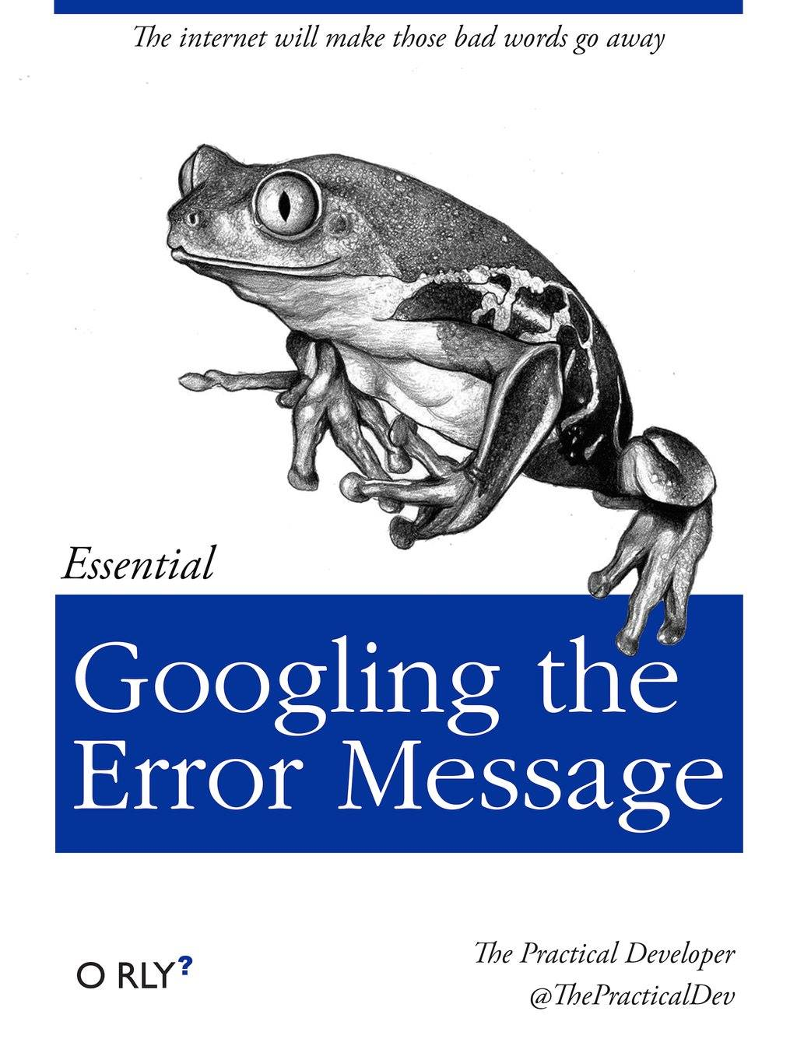
It is possible to “get better” at debugging
Debugging is NOT just “googling the error message”
Some developers are better at debugging than others
The overall goal in this lesson is to teach you about different strategies for debugging, how to decide which strategy to apply, and how to view debugging as a science
Notes:
Suggested “warm up” discussion: Ask students to describe how they debug.

Slide 4
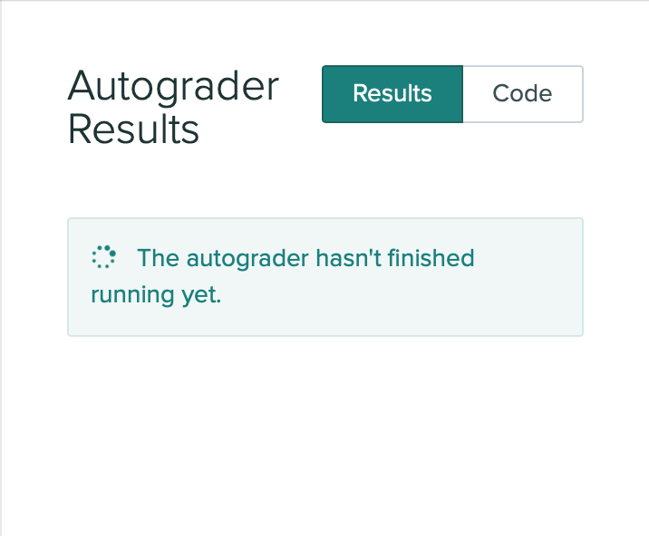
General Strategy: Enable Efficient Reproduction of the Problem
If you haven’t fixed the bug yet, it’s likely you will need to execute the program many times, tweak things, and see what happens
Create the fastest test case possible to reproduce the bug:
Consider starting “top-down” from the application’s entry point, or “bottom-up” by directly invoking some buggy code
Ensure that it is self-contained
Minimize turnaround time from changes to result:
Make sure that you can quickly recompile your code and run the test
Notes:
Consider an example of debugging HW2: You are failing some test on gradescope. The test tells you what it is checking for. You have two options:
1. Keep making changes and upload to gradescope. It will require you to switch to terminal, run npm run zip, open gradescope, upload zip, wait for autograder to run, then get the results, scroll through page to find the test you were interested in. And you can’t see console output. (we hide that on purpose, to discourage debugging-by-console.log on gradescope!)
2. Write a simple test that you can run locally in VSC by hitting F12, or whatever keystroke you have set. The test doesn’t even need to have an assertion – that would be GREAT, but if it’s faster to just get something that shows some output that you can quickly look at, then huzzah!
More broadly, making it more efficient to reproduce the problem might also involve adding log messages so that it’s easier to tell when the problem manifests

Slide 5

General Strategy: Scientific Debugging
Create a debugging log:
What was the input/application state that caused the bug?
What was the behavior that I expected?
What was the behavior that I observed?
What are possible hypotheses for that behavior?
How have I tested those hypotheses, and what was the result?
Do this in an issue tracker, or even in a personal note
Notes:
Once we are able to reproduce the bug, the next step is to start debugging. Most bugs that you are likely to run-into are deterministic: the same bug results from the same input. This means that we can systematically poke at the code until we find the root cause or fix the bug
<read slide>
The key idea for the debugging log is that: if you can’t debug an issue in the first few minutes, it’s unlikely that you will be able to remember all of the things that you have tried, why you tried them, and what else you meant to try. Even worse, you might end up feeling “certain” that you had tried to see if X was the cause, when in reality, you hadn’t, and X was the cause. There is no formal notation to consider for this log, but it’s important to jot down these kinds of questions.
The TAs will ask you this information if you ask for help debugging, so save a step and write it out while you try and solve your problem yourself!

Slide 6
Generating Hypotheses: Why is this buggy?
Good hypotheses are testable
Start with a few hypotheses, and let your inquiry drive the generation of new hypotheses
Determine if you need to know exactly why the bug occurred, or fixing it is good enough
Has recent code that I’ve added introduced this bug?
Have I seen a similar bug before?
Have I made an incorrect assumption about how a library or API works?
Notes:
The overall goal with hypothesis formulation is to come up with possible causes for why the bug exists. Then, as long as those hypotheses are testable, we can prove or disprove them. As you generate hypotheses, you might want to keep in mind whether it’s important to find out precisely what the root cause of the bug was, or if a high-level fix is sufficient. For example, perhaps you run into a problem with ESLint, which is solved by deleting the node_modules folder and reinstalling. This is probably a satisfactory solution, but if you were the maintainers of ESLint, you might want to know more about why the bug happened
For example: if we want to test if a recent change to the code introduces this bug, we could try to reproduce the bug on an older version.
Most hypotheses will be along the lines of “did I make an incorrect assumption about how a library or API works”. The devil is in enumerating all of the possible incorrect assumptions that you might have made, and testing them. The best way to attack these kinds of problems is to start with testing some high-level, general assumptions, and then refine them. We’ll look at some strategies for generating and testing hypotheses.

Slide 7
High-Level Debugging and Hypothesis Generating Strategies
Use focused queries on the web to search for insights
Confirm that (assumed) preconditions actually hold
Find the difference between a working and failing:
Version of your code
Inputs to your code
Environments where your code runs
Notes:
Here are some generic, high level strategies that you can use for debugging, and also to help you form hypotheses as to why the bug exists. You are probably familiar with all of these, and likely have tried each of these at some point. We think that it’s a good idea to internalize this list of high-level debugging strategies, and if you reach a “head-scratcher” of a debugging challenge, make sure that you’ve tried each of these before looking for more drastic solutions.
Notes:
OK #1 is just “google it”, but don’t just copy/paste the error message. Try to generalize your problem: what is the behavior that you are seeing, what do you expect? Try to learn more about what the behavior might be, even if the first result isn’t a stackoverflow post that says “here is the fix”
#2 is to help us find the: “Oh, it says that this code will never handle null inputs. But, I am passing null.” – it’s annoying that these pre condtions are sometimes specified but not machine checked, but it’s a good place to look for an answer to your bug.
#3 is about differential debugging. If you probe sufficiently deep between a failing execution and a passing execution, you might get some insights into why it is failing. If you use git, you could roll back to a version of the code that works (git even has a tool, git bisect to help search a wide range of changes for one where you find that the code behaves differently). Or, you might find that your code passes on some inputs, but fails on others – by finding the minimal difference between a passing and a failing input, you might find the cause of that failure. Or, maybe you find that your code fails on your computer, but not on your teammates?

Slide 8
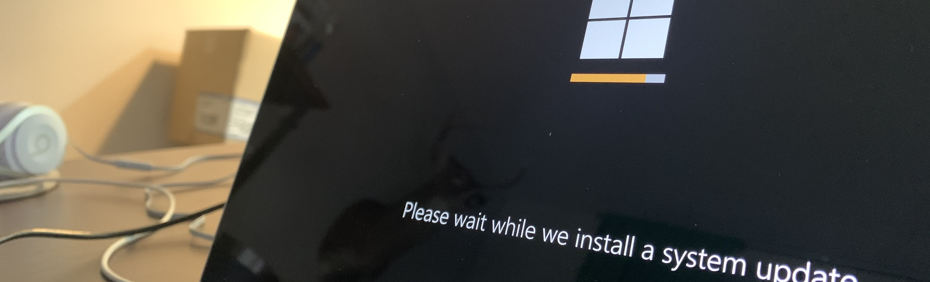
“Is there an updated version of this library?”
Consider updating all dependencies, or just those related to bug
Be prepared to revert to old versions if needed
For NodeJS:
rm -rf node_modules && rm -rf package-lock.json && npm install
Notes:
Our code is probably not the only code with errors. The compiler, language runtime, and all of the libraries that we use might, too. Consequently, updating libraries might help correct some obscure bug in a library we are using.
Have a sensible back-up plan to revert the upgrades in case it makes things worse!

Slide 9

Reasoning Through Code
Carefully examine each line of code, explaining to yourself, your colleague, or “a rubber duck” what it should do
Represent complex data structures (and their manipulation) on paper, or in a separate text file
Notes:
This debugging strategy is called “rubber duck” debugging, and many developers will attribute it to help them fix most of their problems.
A bug occurs when we write code that we think does one thing, but it does something else. Hence, a debugging strategy is to simply examine each line of your code and narrate what you think it should be doing. You could be explaining to a colleague, or if you’re alone, you could be explaining to a rubber duck (hence the name). Typically half-way through the explanation you’ll exclaim “oh, wait, look how silly I am, :facepalm: that’s the problem right there!”
By explaining your code (either to someone else, or pretending to), you engage different parts of your brain, and will start to think about the code from the perspective of what you are reading that it does, as opposed to what you think it should do.
For particularly complex pieces of code, you might also find it useful to draw out complex data structures <read slide>

Slide 10
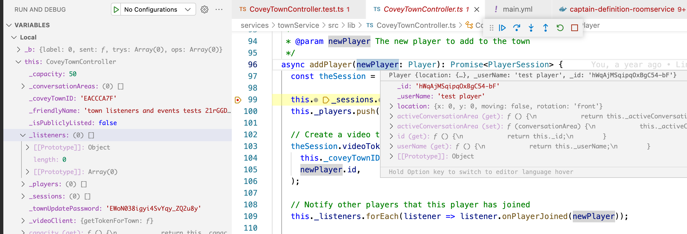
Use A Debugger
Helps narrow down on the code that interests you
Set breakpoints
Look for errors by examining values of variables and expresisons
Get comfortable with the keyboard commands to quickly interact with the debugger
Notes:
Debuggers are specialized tools built just for the purpose of helping you debug. So, if you need to debug something, it’s probably a good idea to get familiar with using a debugging tool. This is a screenshot of VSC’s debugger, on the Covey.Town project.
A debugger will let you advance the execution statement-by-statement (including stepping “into” method calls). Of course, it is usually not feasible to step through EVERY statement – it would be a slow process.
However, using a debugger interactively can help you narrow down to the code that interests you. Perhaps you hypothesize that there is a bug in some method. Set a breakpoint at the start, and set one at the end. Examine the values of variables and expressions at the start and end. If everything still looks OK at the end, then maybe you should look somewhere else. If you see that the error occurs in the method, then run the program under your debugger again, and step more carefully through the execution.
You should get comfortable with the keyboard commands to quickly interact with the debugger – for the same reason why it’s important to be able to reproduce a failure quickly (because you will need to do that task a lot), it’s also important to be able to navigate through a debugger quickly, because you might have to do so quite a bit!

Slide 11
Add Logging Statements
Add log messages to help you understand the program’s execution
Particularly useful for non-deterministic bugs (“heisenbugs”), or bugs that involve many systems interacting
Consider using a logging library to help you trace the source of each log message – log messages are a useful artifact for future debugging
Successfully reuqested job
JWT token might be expired, renewing
Renewing JWT token
Renewing JWT token: success
Received runner launch request:
{
"gitHubURL": "https://github.com/neu-se/covey.town",
"launcherToken": "asdfasdfasdfadsfwerasdfsdf",
"runnerLabels": "self-hosted"
}
--unattended --replace --url https://github.com/neu-se/covey.town --token $GHTOKEN --ephemeral --work gha_work --labels 'self-hosted'
Making request to slurm:
{"script":"#!/bin/bash\nfunction checkForRunning(){\n sleep 120\n RUNNING=$(grep Running /tmp/gha-stdout | wc -l)\n if [ $RUNNING -eq 0 ]; then\n echo \"Does not look like GHA found a job to work on!\"\n kill $$\n fi\n}\nset -x\nhostname\nexport HOME=/tmp/home/ci-runner\necho \"GHA Runner is loading...\"\necho $HOME\ncd $HOME\npwd\nmkdir gha\ncd gha\ncp /experiment/util/actions-runner-linux-x64-2.285.1.tar.gz .\ntar xzf actions-runner-linux-x64-2.285.1.tar.gz\nTOKEN=asdfasdfasdfadsfwerasdfsdf\nGHTOKEN=$(curl -s -X POST -H \"Authorization: $TOKEN\" https://ci.in.ripley.cloud/gha/runner | jq -r '.token')\necho --unattended --replace --url https://github.com/neu-se/covey.town --token $GHTOKEN --ephemeral --work gha_work --labels 'self-hosted' \n./config.sh --unattended --replace --url https://github.com/neu-se/covey.town --token $GHTOKEN --ephemeral --work gha_work --labels 'self-hosted' \ncheckForRunning &\n./run.sh\n","job":{"comment":"GitHub Actions Builder for https://github.com/neu-se/covye.town","name":"GitHubActions","ntasks":1,"partition":"gha","standard_output":"/tmp/gha-stdout","standard_error":"/tmp/gha-stderr","current_working_directory":"/tmp","environment":{"fooo":"bar"}}}
Notes:
This is the formal strategy for “Add printlns”
Some might say that “Logging statements are only used by those who don’t know how to use a debugger.” There are, however, a variety of cases where a log might be more useful than an interactive debugger, for example, if you have a bug that occurs non-deterministically (so called “heisenbugs”). If the bug only shows up on 1 out of 100 executions, it might be more productive to add a logging statement to help you understand WHY it only happens on those 1 out of 100, and then focus on reproducing and fixing that with a debugger.
For example, the log messages on the right are quite verbose, but Prof Bell found them to be useful when debugging an issue with code that connects GitHub Actions’ continuous integration framework with Northeastern’s Slurm high performance computing cluster. There are many small applications that need to function successfully for this to work, and adding logging messages to each microservice was easier than attaching a debugger to all of them.
Well-written log messages (for instance, those that are found to be most useful when debugging, and are configurable to be disabled when not debugging) also serve to create a useful artifact for future you (or someone else) who needs to debug other issues related to what you are fixing now: the log messages will already be in place! This is a good argument for using a configurable logging library.

Slide 12
Write Automated Tests
Encode the minimal steps to reproduce the bug and the expected result in a test
Simplifies reproduction and evaluating fixes
Detects regressions
describe('Create student', () => {
it('should return a valid ID', async () => {
const createdStudent = await client.addStudent('Avery');
expect(createdStudent.studentID).toBeGreaterThan(0);
});
})
Example test that might be useful if this input revealed a bug in student ID generation
Notes:
Once you have some understanding of the code region that you suspect contains the bug, writing a unit test that can confirm that suspicion is great for a few reasons:
Makes it super fast to reproduce!
Provides a reasonable oracle to tell you when you’ve fixed it (test passes)
The test serves as an artifact for future you (or other developer) working in this code, can help detect a regression
You also might need to write a unit test if you are reporting a bug in someone else’s code (either in your org, or in an open source project) and expect them to fix it. Considering our discussion of how hard it can be to isolate and reproduce a bug, providing a developer with a unit test that demonstrates the bug and can be used to determine when it’s fixed is a tremendous help.

Slide 13
Add Assertions
Capture what you think the state of your program should be in assertions
Assertions are a form of documentation
Common assumptions to check:
Pre-conditions and post-conditions of functions
After calls to APIs that are expected not to fail
After loading remote resources
After evaluating complex expressions to make sure that the result has some expected property or is otherwise reasonable
In the “default” case of a switch statement
Notes:
An automated test like the example on the last slide can help us reproduce a bug and confirm if we’ve fixed it, but does not necessarily help us pinpoint the exact location and cause of the bug.
Assertions can help us to localize a bug to a specific root cause, and also to understand what that root cause is. Many times, bugs occur because we make invalid assumptions about how some piece of code will behave. Assertions let us capture those assumptions about how the code should behave in runtime checks that will allow us to detect when one is violated. You can use assertions to document your understanding of the code as you debug it, and they can be useful documentation for future developers inspecting that code.
Here are some examples of the kinds of assumptions that you might want to check with assertions (read examples slide)

Slide 14
Use a specialized debugging tool
Example: Valgrind for C/C++ Memory Errors
$ valgrind ./main
==8515== Memcheck, a memory error detector
==8515== Copyright (C) 2002-2015, and GNU GPL'd, by Julian Seward et al.
==8515== Using Valgrind-3.11.0 and LibVEX; rerun with -h for copyright info
==8515== Command: ./main
==8515==
==8515== Conditional jump or move depends on uninitialised value(s)
==8515== at 0x400813: fail() (main.cpp:7)
==8515== by 0x40083F: main (main.cpp:13)
==8515==
==8515== Invalid read of size 4
==8515== at 0x400819: fail() (main.cpp:8)
==8515== by 0x40083F: main (main.cpp:13)
==8515== Address 0x0 is not stack'd, malloc'd or (recently) free'd
==8515==
==8515==
==8515== Process terminating with default action of signal 11 (SIGSEGV): dumping core
==8515== Access not within mapped region at address 0x0
==8515== at 0x400819: fail() (main.cpp:8)
==8515== by 0x40083F: main (main.cpp:13)
==8515== If you believe this happened as a result of a stack
==8515== overflow in your program's main thread (unlikely but
==8515== possible), you can try to increase the size of the
==8515== main thread stack using the --main-stacksize= flag.
==8515== The main thread stack size used in this run was 8388608.
==8515==
==8515== HEAP SUMMARY:
==8515== in use at exit: 72,704 bytes in 1 blocks
==8515== total heap usage: 1 allocs, 0 frees, 72,704 bytes allocated
==8515==
==8515== LEAK SUMMARY:
==8515== definitely lost: 0 bytes in 0 blocks
==8515== indirectly lost: 0 bytes in 0 blocks
==8515== possibly lost: 0 bytes in 0 blocks
==8515== still reachable: 72,704 bytes in 1 blocks
==8515== suppressed: 0 bytes in 0 blocks
==8515== Rerun with --leak-check=full to see details of leaked memory
==8515==
==8515== For counts of detected and suppressed errors, rerun with: -v
==8515== Use --track-origins=yes to see where uninitialised values come from
==8515== ERROR SUMMARY: 2 errors from 2 contexts (suppressed: 0 from 0)
$ ./main
Segmentation fault (core dumped)
https://www.valgrind.org/info/tools.html
Notes:
Some classes of bugs are so common and so difficult to debug that there are specialized debugging tools created just for those reasons.
For example, if you’ve ever written a C or C++ program, it’s likely you’ve also written code with memory errors that results in a segmentation fault. These are hard to debug. But, when running your program with ‘valgrind’, you get a much more useful error when the program crashes: a description of the memory error that happened, and where in the code it happened.
We’ll see another example of a domain-specific debugging tool when we get to React – the React developer tools are a very useful suite of debugging extensions that are particularly useful for debugging React rendering problems.

Slide 15
Set Yourself Up For Debugging Success
Invest in growing your experience of applying these debugging strategies
For complex problems:
Consider each of these debugging strategies
Use a notebook to keep track of what you’ve tried
Take a break! Do not spend more than a few hours at a time in a debugging session
Be persistent

Slide 16
Review: Learning Objectives for this Lesson
By the end of this lesson you should be able to:
Understand the value of scientific debugging
Enumerate general debugging strategies beyond “google it” or “turn it off and on again”

